Slide 1
Decision Making in The Face of Uncertainty
@garyshort

Slide 2
We’re The Folk In The Prognet Crew, Who The Hell Are You?!
Gary Short
Founder Duncodin Limited
15 years software engineering experience
10 years data scientist
Ex Microsoft MVP C#
Ex Microsoft Data Scientist
gary@duncodin.it
@garyshort
https://github.com/garyshort

Slide 3
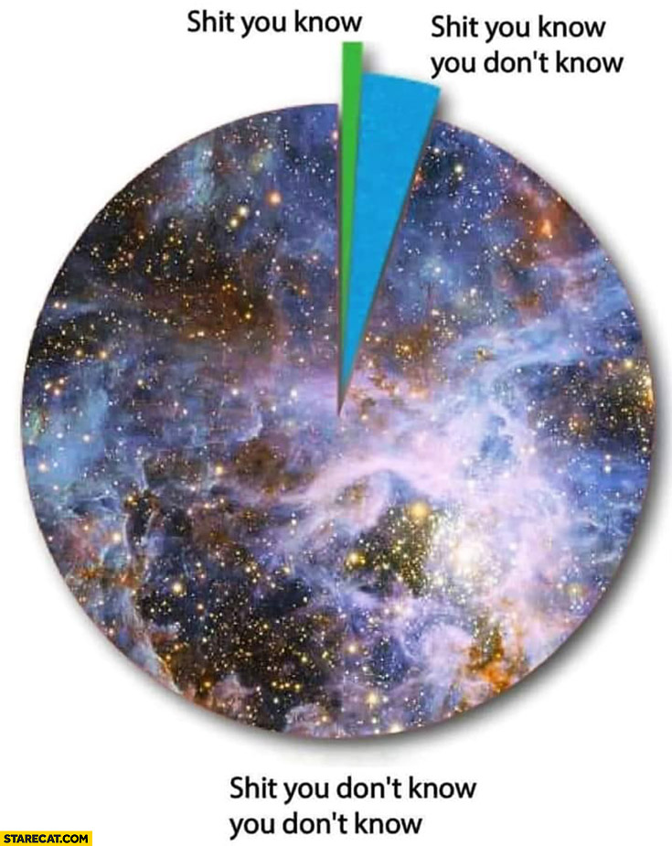
What are we doing here?

Slide 4
The Duncodin Manifesto
We believe in evidence based decision making.
We believe you are entitled to your own opinion, not your own facts.
We believe a good estimate is better than a great guess.
We believe in enumerating our biases before decision making.
We believe in the principles of forecasting.
We believe in simulation when variable starting values are not known.
We believe in minimizing the downside of our decisions.
We believe in calibrating our predictions and decisions.

Slide 5
The Duncodin Method
Where evidence is not available make good estimates
Apply forecasting rules
Apply Bayesian rules to the evidence and estimates
Apply simulation to unknown or non fixed evidence and estimates
Collect Evidence
Calibrate all decisions
Hedge your decisions
Evaluate Evidence

Slide 6
Collect Evidence
We believe in evidence based decision making

Slide 7
Evaluate The Evidence
We believe you are entitled to your own opinion, not your own facts

Slide 8


Slide 9
Make Estimates
We believe that a good estimate is better than a great guess

Slide 10
Fermi Problems
There are approximately 9,000,000 people living in the Chicago metropolitan area.
On average, there are two people in each household in Chicago.
Roughly one household in twenty has a piano that is tuned regularly.
Pianos that are tuned regularly are tuned on average about once per year.
It takes a piano tuner about two hours to tune a piano, including travel time.
Each piano tuner works eight hours in a day, five days in a week, and 50 weeks in a year.
From these assumptions, we can compute that the number of piano tunings in a single year in Chicago is…
(9,000,000 persons in Chicago) ÷ (2 persons/household) × (1 piano/20 households) × (1 piano tuning per piano per year) = 225,000 piano tunings per year in Chicago.
We can similarly calculate that the average piano tuner performs…
(50 weeks/year) × (5 days/week) × (8 hours/day) ÷ (2 hours to tune a piano) = 1000 piano tunings per year.
Dividing gives…
(225,000 piano tunings per year in Chicago) ÷ (1000 piano tunings per year per piano tuner) = 225 piano tuners in Chicago.
In 2009, the actual number of piano tuners in Chicago was about 290

Slide 11
Apply Forecasting Principles
We believe in the principles of forecasting

Slide 12
Triage
Break seemingly intractable problems into tractable sub-problems
Strike the right balance between inside and outside views
Strike the right balance between under- and overreacting to evidence
Look for the clashing causal forces at work in each problem
Strive to distinguish as many degrees of doubt as the problem permits but no more
Strike the right balance between under- and overconfidence, between prudence and decisiveness
Look for the errors behind your mistakes but beware of rearview-mirror hindsight biases
Bring out the best in others and let others bring out the best in you
Master the error-balancing bicycle

Slide 13
Apply Bayesian Rules
We believe in enumerating our biases before decision making

Slide 14
P(A|B) = P(B|A) * P(A) / P(B)

Slide 15
There is a dread disease that is 100% fatal.
The incidence of this disease in 1 in 100,000.
The test for this disease is 99% accurate.
You get the test.
It comes back positive for the disease.
Should you be worried?

Slide 16
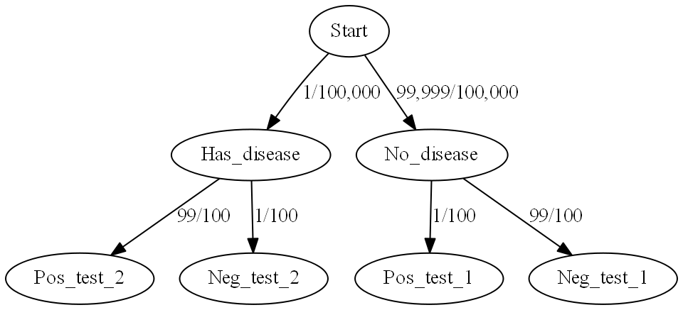

Slide 17
P(D|P) = P(P|D) * P(D) / P(P)

Slide 18
P(D|P) = P(0.99) * P(0.00001) /(0.009 + 0.00000099)

Slide 19
P(D|P) = ~ 0.1%

Slide 20
Use Simulation
We believe in simulation when variable starting values are not known

Slide 21
Monte Carlo Simulation
For each measure in a collection of evidence
Sample a value
Perform a deterministic function with the collection of sampled values
Collect all results of the function
Run a frequency distribution over the results
This will be a Normal distribution, so the normal mean and SD rules apply.

Slide 22
What Probabilistic Distribution Should I Sample From?
If the variable can hold:
Any discrete value – Natural Distribution
True or false for a given probability – Binomial Distribution
Any X of Y true/false tries – Bernoulli Distribution
The number of occurrences (of constant average rate) in T time interval – Poisson Distribution.

Slide 23
Hedge Your Predictions
We believe in minimizing the downside of our decisions.

Slide 24
Calibrate Your Predictions
We believe in calibrating our predictions and decisions

Slide 25
Okay Folks, It’s Your Turn!
Need some inspiration? Try: https://www.gjopen.com/questions

